Slide 1
Endangered Species
Population

Slide 3
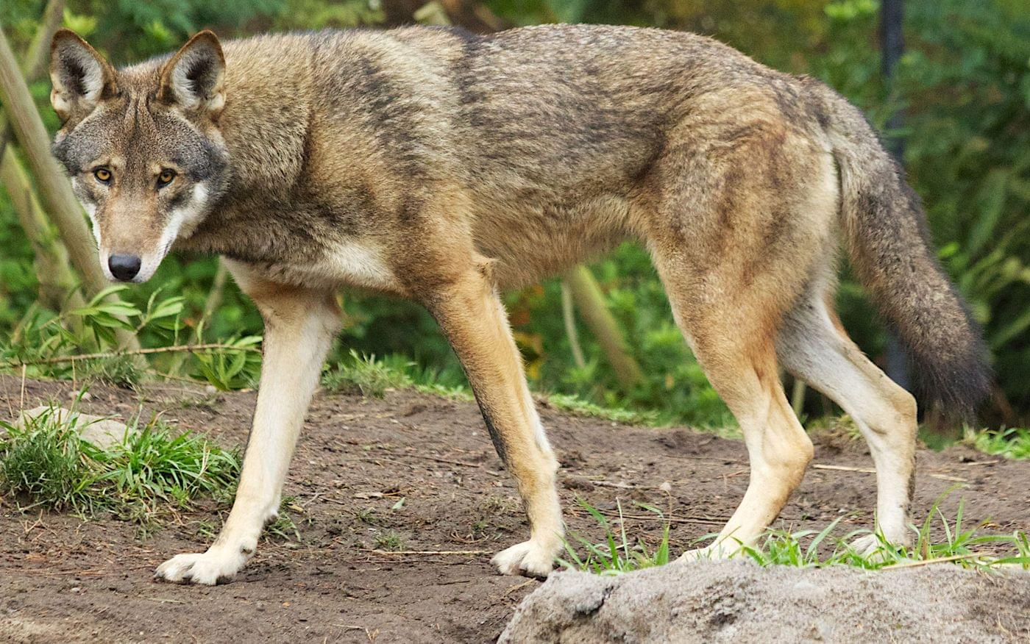
picture
https://www.fws.gov/southeast/wildlife/mammal/red-wolf/

Slide 4
American Red Wolves
Discription

Slide 5
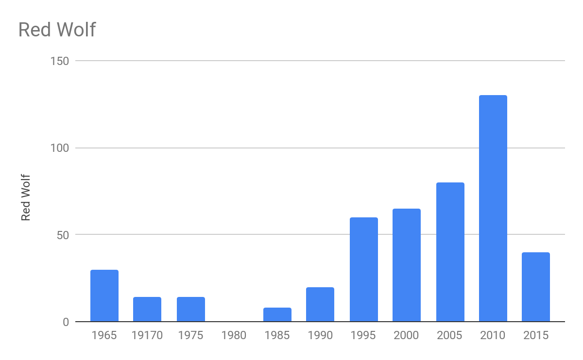

Slide 6
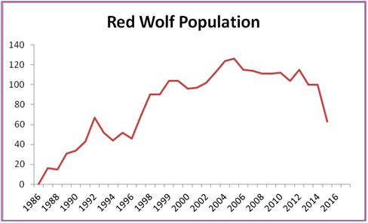

Slide 7
All numbers are estimates based off of the Fish and Wildlife services (USA department)
 | 1965 | 19170 | 1975 | 1980 | 1985 | 1990 | 1995 | 2000 | 2005 | 2010 | 2015
Red Wolf | ~30 | ~14 | 14 | ~0 | 8 | 20 | 60 | 65 | 80 | 130 | 40

Slide 8
Issues with the data
Different studies will find different numbers
Captivity vs wild
Hybrid vs purebred

Slide 9
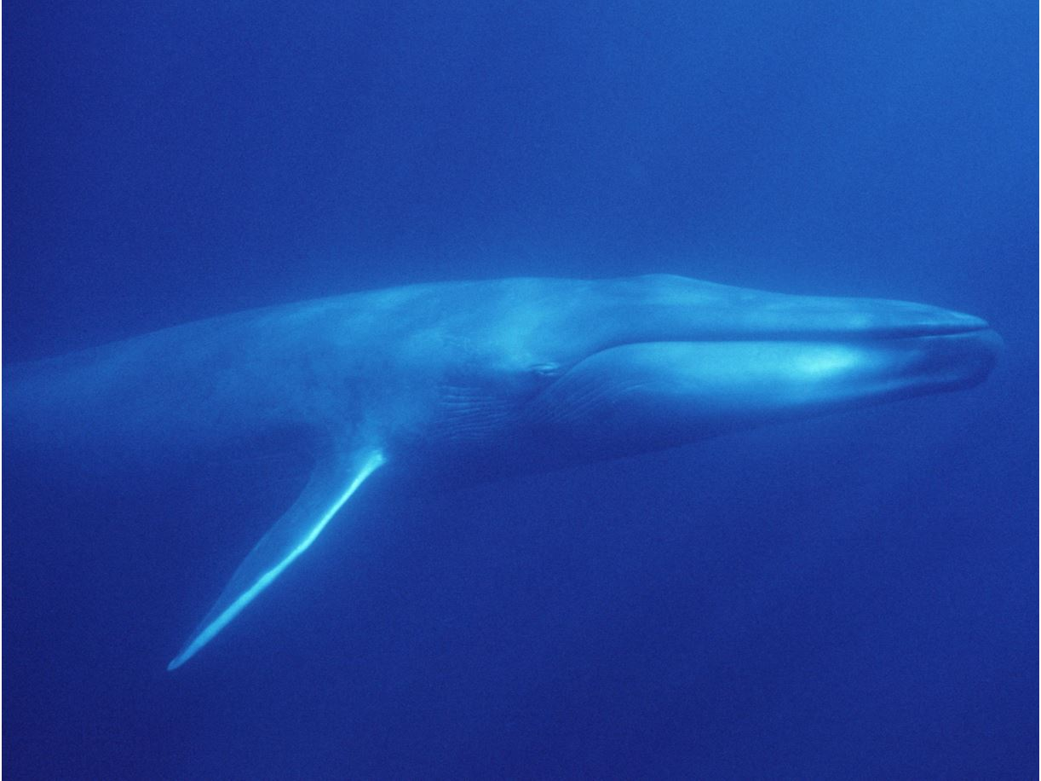
https://www.montereybayaquarium.org/animal-guide/marine-mammals/blue-whale

Slide 10
Blue whale

Slide 11
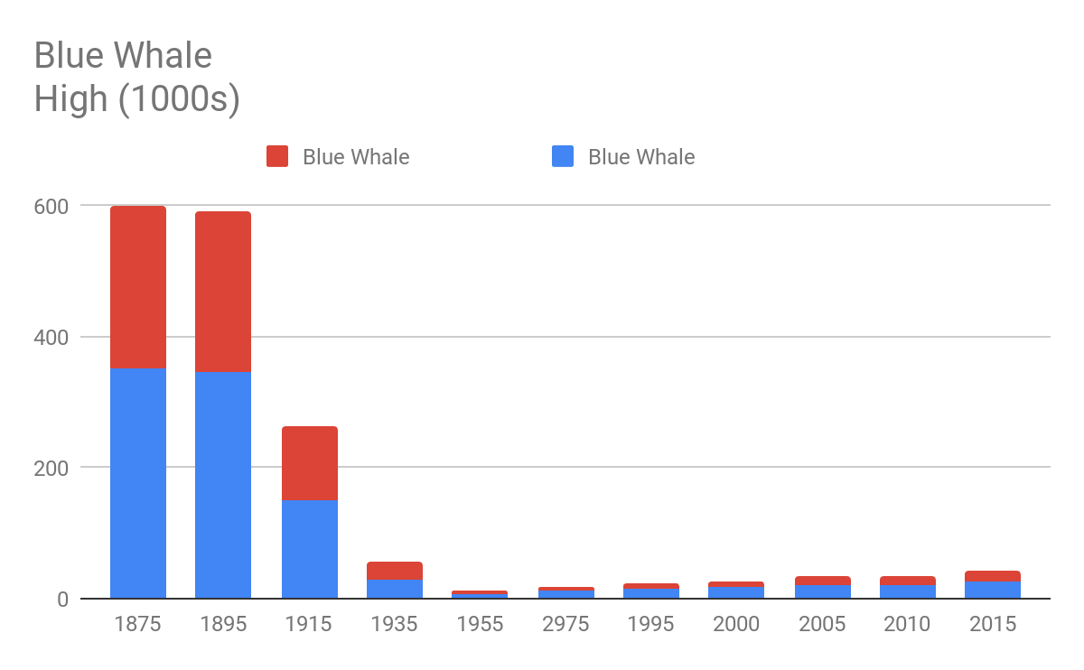

Slide 12
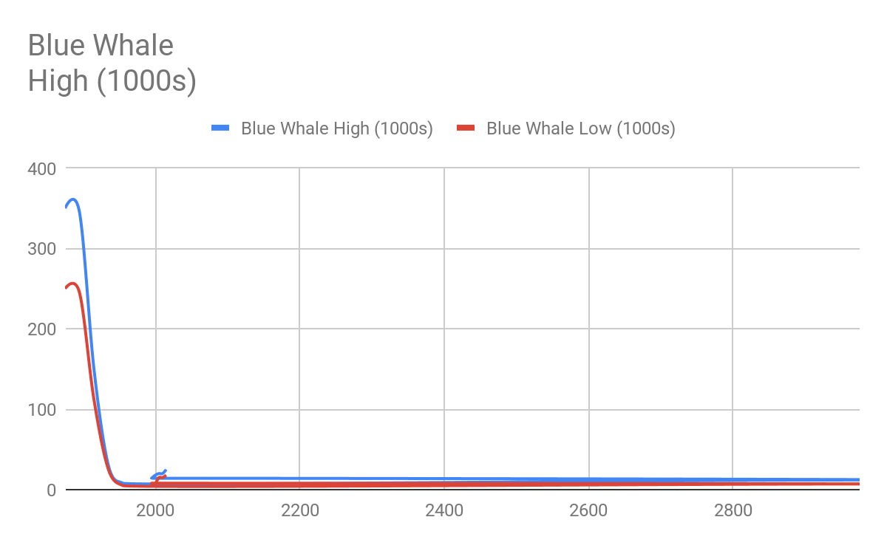

Slide 13
Blue Whales are an aquatic species. This makes the recording of population a near impossible task. The following is the high and low estimates of the blue whale population.
 | 1875 | 1895 | 1915 | 1935 | 1955 | 2975 | 1995 | 2000 | 2005 | 2010 | 2015
Blue Whale High (1000s) | 350 | 345 | 150 | 30 | 8 | 12 | 14 | 18 | 20 | 20 | 25
Blue Whale Low (1000s) | 250 | 245 | 112 | 25 | 5 | 7 | 8 | 8 | 15 | 15 | 18

Slide 15
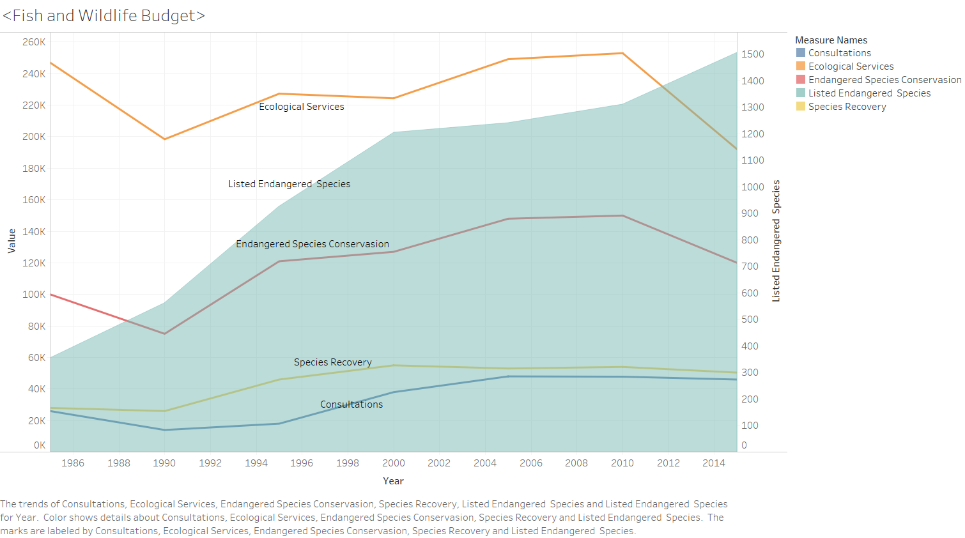

Slide 16
Sources
Center for Biological diversity, SAVING THE RED WOLF
https://cci-dev.org/analysis/ESA_funding/
https://www.biologicaldiversity.org/species/mammals/red_wolf/
http://thetruthaboutredwolves.com/
http://www.nrcresearchpress.com/doi/abs/10.1139/z00-158#.W9ivB2hKhPY
https://www.biologicaldiversity.org/species/mammals/pdfs/Red_Wolf_NOI_3-24-2016.pdf
https://digitalcommons.unl.edu/usgsnpwrc/319/
https://books.google.com/books?hl=en&lr=&id=_mXHuSSbiGgC&oi=fnd&pg=PR7&dq=red+wolf+population&ots=cQd1Ypo_f7&sig=Bo5wZth7_DE6IeFINtl6VPT1t40#v=onepage&q=red%20wolf%20population&f=false

Slide 17
Blue Whale sources
https://web.archive.org/web/20070711025158/http://www.acsonline.org/factpack/bluewhl.htm
https://www.worldwildlife.org/species/blue-whale
https://ezproxy.tcnj.edu:2177/doi/full/10.1111/j.1748-7692.2009.00298.x
https://ezproxy.tcnj.edu:2177/doi/abs/10.1111/j.1748-7692.1999.tb00888.x

